Slide 1


Master in Innovation and Research in Informatics (MIRI)
Data Mining and Business Intelligence track.
Big Data and L_{p}–norm estimators
Dott. Massimiliano Giacalone
massimiliano.giacalone@unina.it

Slide 2




Innovative Methods for the Developments of a Notoriety System
Buondonno - M. Giacalone - A. Romano -
V. Santarcangelo

Slide 3
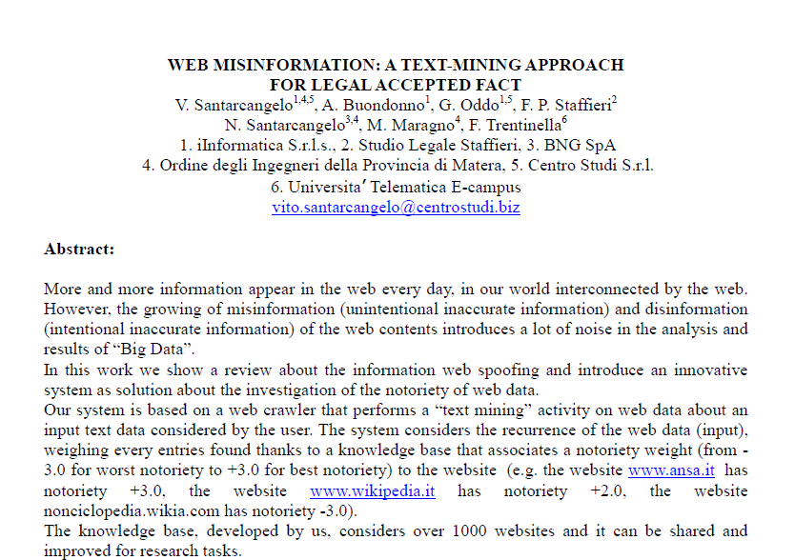
STATE OF THE ART

Slide 4
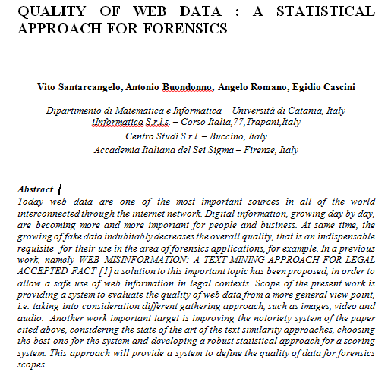
STATE OF THE ART

Slide 5

A LEGAL PROBLEM
Art. 2697 c.c.
“ Chi vuol far valere un diritto in giudizio deve provare i fatti che ne costituiscono il fondamento”
↓
EVIDENCE

Slide 6
A LEGAL PROBLEM
Art.115 c.p.c.
1° comma (The Rule)
“ Salvi i casi previsti dalla legge, il giudice deve porre a fondamento della decisione le prove proposte dalle parti o dal pubblico ministero……”
↓
Only what it has been proved can base the decision of the judge

Slide 7
A LEGAL PROBLEM
Art. 115 c.p.c.
2° comma (Exception)
“Il giudice può tuttavia, senza bisogno di prova, porre a fondamento della decisione le nozioni di fatto che rientrano nella comune esperienza”
↓
NOTORIETY FACT
Problem: news circulating on the web, can be considered common knowledge?

Slide 8
A LEGAL PROBLEM
The answer of the Court
Tribunale di Mantova
(Ordinanza del 16 maggio 2006)
↓
The information acquired through the Internet can not
defined notions of shared experience
↓
Nullity of expertise that brings the concept
taken from the web

Slide 9

A LEGAL PROBLEM
Corte di Cassazione
(sentenza del 18 novembre 2014, n. 24599)
↓
The notion of notoriety knowledge must be interpreted
restrictively

Slide 10

A LEGAL PROBLEM
Advantages of the well-known fact
↓
Reducing the duration of the investigation phase
↓
Reduction in process times

Slide 11
A LEGAL PROBLEM
Regulatory parameters
● Art.111 della Costituzione
“ Ogni processo si svolge nel contraddittorio tra le parti, in condizione di parità, davanti a un giudice terzo e imparziale.
La legge ne assicura la ragionevole durata”
● Art. 6 della Convenzione Europea dei Diritti dell’Uomo
“ Ogni persona ha diritto a che la sua causa sia esaminata equamente, pubblicamente ed entro un termine ragionevole….”

Slide 12
MISINFORMATION AND DISINFORMATION
However, the web information can present also inaccurate information (web information spoofing).
This kind of problem is growing day by day.
Misinformation is the unintentional inaccurate information
Disinformation is the intentional inaccurate information
These two problems introduce lot of noise in the analysis and results of “Big Data”.
From “WEB MISINFORMATION: A TEXT-MINING APPROACH FOR LEGAL ACCEPTED FACT”

Slide 13
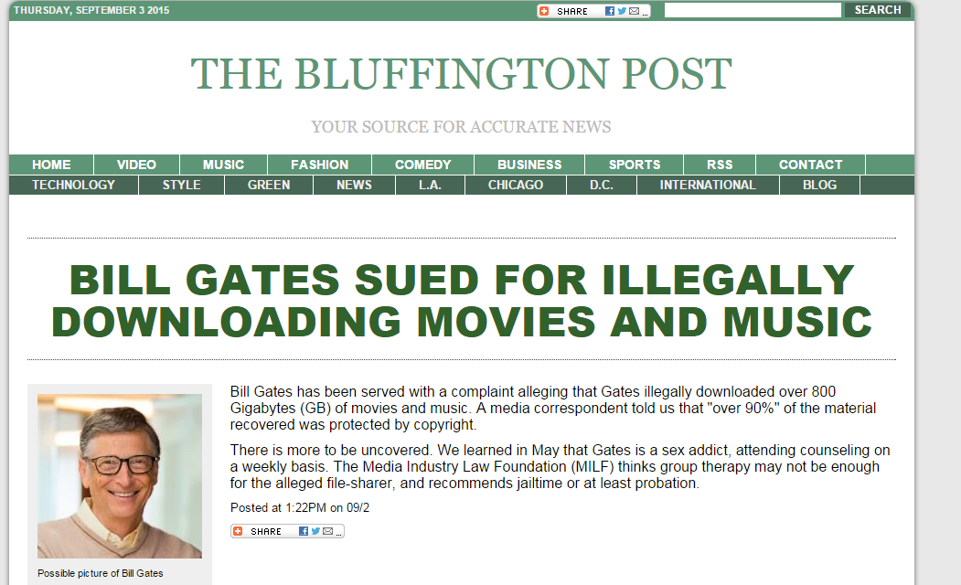

TOOL FOR DISINFORMATION

Slide 14
NOTORIETY SYSTEM
USER INPUT
WEB
CRAWLER
PARSER
TEXT ANALYZER
DB
NOTORIETY
DATA EXTRACTION
NOTORIETY
ANALYZER
Text Similarity score
NOTORIETY
OUTPUT
From “WEB MISINFORMATION: A TEXT-MINING APPROACH FOR LEGAL ACCEPTED FACT”

Slide 15
NOTORIETY KNOWLEDGE BASE
Database of over1000 entries (shared for improvement)
Score from +3.0 (better notoriety) to -3.0 (worst notoriety)
.edu / .gov.it / .int / .museum (Score +3.0)
WEBSITE | NOTORIETY | APPLICATION FIELD
www.ansa.it | +3.0 | News
www.wikipedia.it | +2.0 | General
nonciclopedia.wikia.com | -3.0 | Funny
www.istruzione.it | +3.0 | Institutional
www.uniba.it | +3.0 | Institutional
www.sportnotizie24.it | +1.0 | SportNews
www.barzellette.net | -3.0 | Funny
www.bufale.net | -3.0 | Funny
www.altervista.org | -1.0 | Web Hosting
From “WEB MISINFORMATION: A TEXT-MINING APPROACH FOR LEGAL ACCEPTED FACT”

Slide 16






METRIC
INFORMATION
MISINFORMATION
DISINFORMATION
DB NOTORIETY WEIGHT
TEXT SIMILARITY SCORE
n number of website extracted
From “WEB MISINFORMATION: A TEXT-MINING APPROACH FOR LEGAL ACCEPTED FACT”

Slide 17
LIMITS OF THE APPROACH CONSIDERED
Text Similarity accuracy
Problems about “notoriery website that writes about fake news”
Weight accuracy
From “QUALITY OF WEB DATA: A STATISTICAL APPROACH FOR FORENSICS ”

Slide 18
Text mining approaches
In our metric-approach, φ(xi) is an important weight for getting a good score.
This score estimates how the results are near to what we were searching for.
This approach is applied on the input text and the titles of the crawler’s results
Text similarity approaches are based on 2 different methods : Literal and Semantic
From “QUALITY OF WEB DATA: A STATISTICAL APPROACH FOR FORENSICS ”

Slide 19
Literal approach
Literal approach consists in a string-based method for calculating character by character similarity among strings
It was the first method developed for text similarity.
Example of algorithm using this are: Longest Common SubString (LCS), Damerau-Levenshtein,Jaro–Winkler, N-gram,Cosine similarity, Jaccard similarity,Sørensen index or Dice's coefficient
WEAKNESS :
No capacity to compare synonimus and to get semantic relatedness between words like in the human language.
WORDS
From “QUALITY OF WEB DATA: A STATISTICAL APPROACH FOR FORENSICS ”

Slide 20
Semantic approach
CONCEPTS
It is used in the modern search engines. It compares two different terms with their Semantic relatedness. It tries to simulate the human way to categorize terms by concepts
This approach can used a statistical or distributional techniques (corpus based), lexical databases (thesaurus), (knowledge based) and hybrid approaches, combining distributional and lexical techniques.
Distributional measures use statistics acquired from a large text corpora (i.e. Wikipedia) to determine how similar the contexts of two words are. The idea is that words that are used in similar contexts tend to be semantically similar
Knowledge-Based Similarity identifies the degree of similarity between words using information derived from semantic networks; like WordNet Nouns
A lot of algorithms are based on distributional measures :
LSA (latent semantic analysis), Pointwise Mutual Information - Information Retrieval (PMI-IR), Hyperspace Analogue to Language (HAL), …

Slide 21
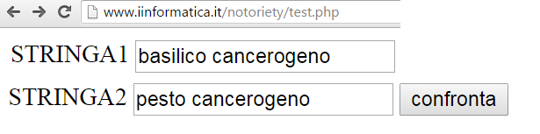
Example
Literal : 75.67%
Semantic: 90.00%
Word1 | Word2 | Relation
Basilico | Pesto | Correlation
Ocimum | Basilico | Synonimous
From “QUALITY OF WEB DATA: A STATISTICAL APPROACH FOR FORENSICS ”

Slide 22
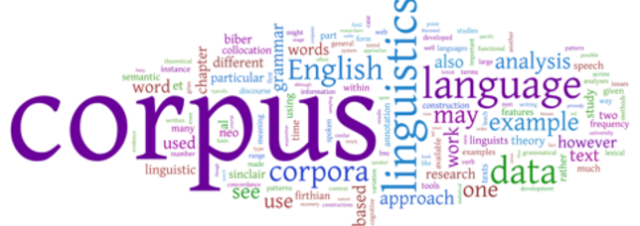

Hybrid approach
It is a combination of corpus and knowledge based and it is considered the best approach way to join good results in text similarity
CONCEPTS
&

Slide 23
OUR IMPROVEMENT
Use of Semantic Thesaurus for a better TEXT SIMILARITY ANALYSIS
Use of the “Fake control”
Use of a better weighting of high score notoriety website
From “QUALITY OF WEB DATA: A STATISTICAL APPROACH FOR FORENSICS ”

Slide 24
“AVE” NOTORIETY SYSTEM
USER INPUT
WEB
CRAWLER
PARSER with FAKE CONTROL
TEXT ANALYZER
DB
NOTORIETY
DATA EXTRACTION
NOTORIETY
ANALYZER
Semantic Text Similarity score
Thesaurus
SEMANTIC
NOTORIETY
OUTPUT
From “QUALITY OF WEB DATA: A STATISTICAL APPROACH FOR FORENSICS ”

Slide 25
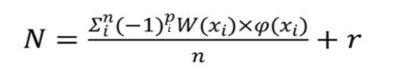
“AVE” SYSTEM LOGIC
parser fake coefficient
text similarity score
intensifier
high quality
notoriety
notoriety
DB weight
Use of Semantic Thesaurus for a better TEXT SIMILARITY ANALYSIS
R = 1 if W(xi) = +3 AND φ(xi)>0,6
else R=0
From “QUALITY OF WEB DATA: A STATISTICAL APPROACH FOR FORENSICS ”

Slide 26
EXAMPLE : MERENDINE
Query: merendine, gelati e bibite tossiche: il centro antitumori chiede massima diffusione
Results :
http://blog.saltoquantico.org/merendine-tossiche/ [-3],[1]
http://www.altroconsumo.it/alimentazione/sicurezza-alimentare/news/bufala-additivi-tossici [+2],[0,29]
http://www.fondazioneveronesi.it/articoli/alimentazione/falsi-allarmismi-ladditivo-delle-merendine-non-e-tossico [+3],[0,26]
http://civitaforum.forumfree.it/?t=71048170 [-2],[0,99]
Final score= -0,9 MISINFORMATION
LITERAL
Using the approach of “WEB MISINFORMATION: A TEXT-MINING APPROACH FOR LEGAL ACCEPTED FACT”

Slide 27
EXAMPLE : MERENDINE
Query: merendine, gelati e bibite tossiche: il centro antitumori chiede massima diffusione
Results :
http://blog.saltoquantico.org/merendine-tossiche/ [-3],[1] (p=0)
http://www.altroconsumo.it/alimentazione/sicurezza-alimentare/news/bufala-additivi-tossici [+2],[0,29] (p=1)
http://www.fondazioneveronesi.it/articoli/alimentazione/falsi-allarmismi-ladditivo-delle-merendine-non-e-tossico [+3],[0,26] (p=1)
http://civitaforum.forumfree.it/?t=71048170 [-2],[0,99] (p=0)
Final score= -1,58 DISINFORMATION
“AVE”
LITERAL
Using the approach of “QUALITY OF WEB DATA: A STATISTICAL APPROACH FOR FORENSICS ”

Slide 28
EXAMPLE : MERENDINE
Query: merendine, gelati e bibite tossiche: il centro antitumori chiede massima diffusione
Results :
http://blog.saltoquantico.org/merendine-tossiche/ [-3],[1] (p=0)
http://www.altroconsumo.it/alimentazione/sicurezza-alimentare/news/bufala-additivi-tossici [+2],[0,4] (p=1)
http://www.fondazioneveronesi.it/articoli/alimentazione/falsi-allarmismi-ladditivo-delle-merendine-non-e-tossico [+3],[0,28] (p=1)
http://civitaforum.forumfree.it/?t=71048170 [-2],[1] (p=0)
Final score= -1,66 DISINFORMATION
“AVE”
SEMANTIC
Using the approach of “QUALITY OF WEB DATA: A STATISTICAL APPROACH FOR FORENSICS ”

Slide 29
SYSTEM IMPROVEMENT
Difficulties to classified all the websites (Big Data Analysis)
Not objective websites score
Necessity to introduce an automatic and objective system
MARKOV CHAIN METHOD (Pagliarani)

Slide 30
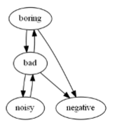
MARKOV CHAIN FOR SENTIMENT CLASSIFICATION
Markov Chain Based Method for In-domain and Cross-domain Sentiment Classiﬁcation using this Approach:
1) Every term in a dictionary is modelled as a Markov chain state semantic information can ﬂow from source speciﬁc terms to target speciﬁc ones through common terms, allowing transfer learning
2) Every category is modelled as a Markov chain state as well classes are reachable from terms, allowing sentiment classiﬁcation

Slide 31
OUR APPROACH FOR NOTORIETY CLASSIFICATION
Our approach
1) every website in a thesaurus is modelled as a chain ‘notoriety information’ can ﬂow from source speciﬁc website to target speciﬁc ones through common news, allowing transfer learning
2)every category is modelled as a chain ‘notoriety information’ as well classes are reachable from news, allowing sentiment classiﬁcation
MISINFORMATION
SITO1
News1
News2
News3
News4
News5
SITO2

Slide 32
EXAMPLE
If a website has a common news with a DISINFORMATION website, then it is classified like a DISINFORMATION website
If a website has a common news with a MISINFORMATION website, then it is classified like a MISINFORMATION website
If a website has ALL news common with INFORMATION website, then the website is classified like INFORMATION website
MISINFORMATION
SITO1
News1
News2
News3
MISINFORMATION
News4
News5
SITO2
MISINFORMATION

Slide 33
EXAMPLE
MISINFORMATION
SITO1
ALTERVISTA
News1
News2
News3
DISINFORMATION
SITO3
NONCICLOPEDIA
INFORMATION
MISINFORMATION
SITO2 [ANSA]
DISINFORMATION
INFORMATION
News5
News4
SITO ??
DISINFORMATION

Slide 34
WORK IN PROGRESS
DEVELOPMENT of a NOTORIETY Web Search Engine, integrable in actual search engines (e.g. notoriery.goxgle.com)

Slide 35
CONCLUSION AND FUTURE WORKS
In this paper we debated about web data notoriety systems considering the only example retrieved in literature with the introduction of some improvements as Markovian model.
There are still a lot of opportunities to improve the potentiality of our algorithm. An idea could be the addition to the text similarity analyser also of a logic of sentiment for a better analysis of the content of a text and the study of the possibility to a user interaction to vote and improve the knowledge base.
Furthermore, we would like to extend this idea to a Search Engine (e.g. using a plugin as Google Chrome Plugin) introducing a notoriety filter able to rank data considering their quality, with the target of making the web as a real repository of quality `information'.

Slide 36
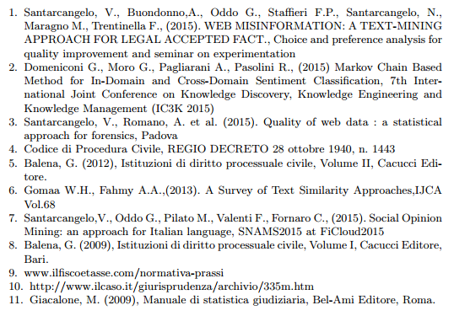
REFERENCES

